Slide 1
MATRIX REPRESENTATION OF GRAPHS

Slide 2
INTRODUCTION
Situation comes when we need a better way out to convert the graphical representation into digital or algorithmic format. A matrix is a convenient and useful way to represent a graph to a computer.
Since, matrix is widely used in mechanical manipulations and also it is efficient enough to define various applications so this chapter is all about
Formation of matrix
Different kind of observations on that matrix

Slide 3
Various types of matrix
Adjacency Matrix
Incidence Matrix
Reduced Incidence Matrix
Sub Matrix
Circuit Matrix
Fundamental Circuit Matrix
Cut Set Matrix
Path Matrix

Slide 4
ADJACENCY MATRIX
With a given graph G , Adjacency or connection matrix is a n by n symmetric binary matrix .
Consider graph has no parallel edge and self loop , because those do not carry redundant information .
Then each element of the graph is defined as:
^{X}i,j
= 1, if there is an edge between i^{th} and j^{th} vertices and
= 0, if there is no edge between them.

Slide 5
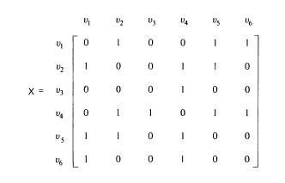
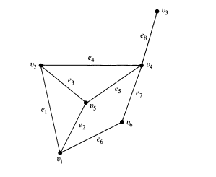
ADJACENCY MATRIX

Slide 6
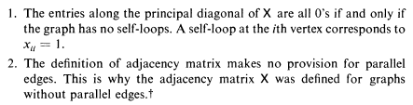

Observations

Slide 7
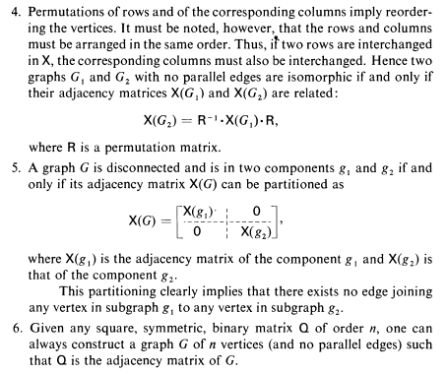
Observations

Slide 8
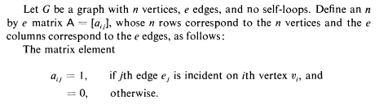
INCIDENCE MATRIX

Slide 9
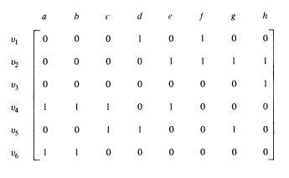
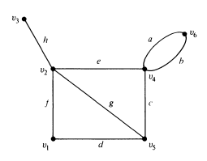
INCIDENCE MATRIX

Slide 10
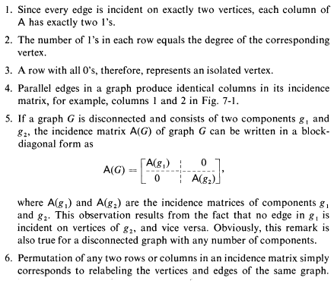
Observations:

Slide 11

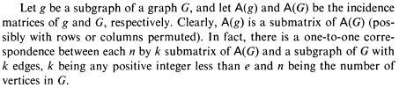
Different Incidence Matrix

Slide 12
Assignment Questions
Define the following with proper diagram
a)Adjacency Matrix b)Incidence Matrix
Why Parallel edges are not considered in Adjacency Matrix?
What is reduced incidence matrix and what is a reference vertex?
Define one sub matrix of an incidence matrix with proper example.
Why self loops are not considered in Incidence Matrix?

